Slide 1

Notes:
Include aspects of Product Sense, Execution and Definition of Success Metrics. Lean on the Syllabus
Team Collaboration: Clearly Established roles for the Product Launch
Personas, Use Cases & Success Metrics researched and defined
Consumer habits and creator habits for creators based on success metrics. What are your success metrics and how will you track? Stating value/feasibility.
Customer Development deliverables: customer interview questions, research, focus group results. Organize into a affinity diagram
Fill out Business Model Canvas, Value Proposition Canvas & Kano (satisfiers/delighters)
Identify what you want to learn about your feature using A/B testing (not thru customer interviews).
Customer Journey Map
Define your MVP and write a simple PRD
Wireframe in Balsamiq
Prototype Demo in Invision
Build a roadmap using Miro
Identify Customer Acquisition channels
Build a go-to-market strategy
Agile Retrospective and create hypothesis based on data

Slide 2
Agenda
1
Signal - current state
2
Addressing the new timeline to continue developing Signal
3
Introducing Signal as a premium feature
4
Signal Demo
5
Summary
Notes:
Detailed Agenda
Signal - current state (Kamile)
Great response from investors
Podcast market segmentation
Signal’s personas and use cases
Addressing the new timeline to continue developing Signal (Laura)
Roadmap moving from a 6 month roadmap to a 6 week roadmap
Given the tighter timeline, you're going to need to find a way to reduce scope and still roll out Signal for maximum impact.
This week require the feature to be paused for two weeks in order to get ahead of it our plan is… (business point instead of technical difficulties - Kamile will add)
Recommendations to increase engagement and revenue; moving signal into a premium feature (Nicole)
Quick overview of data analysis
Finding from the data
Hypothesis concluded from the data
Prototype demo of Signal as a premium feature (Mukul)
A/B testing free trial - wireframes
Prepare 2 - 1 for Nicole - signup+AB testing
2nd
Summary (Nicole)
Short iteration
Results

Slide 3
About Us
We are a podcast publishing platform and community that allows anyone to share their thoughts, connect with others, and discover interesting discussions on a variety of topics.
Venture-backed by a company based in New York and growing quickly
Streamium has over 10k of creators and 50m consumers using the platform every day.

Slide 4





Overview - Product Development Life Cycle
Concept
Research
Analysis
Develop
Launch
Idea Generation
Assess Market
Business Analysis
Product Development
Go to Market
Customer pain
Market studies
Legislation
Competitors
Segment & size
Growth potential
Customer needs
Legal issues
Competition
Cost/Benefit
Resources required
Capital expenses
Profit/Margin
Anticipated sales
Technical specs
Prototyping
Trial production
Testing & QA
Test Market Selling
Marketing plan
Sales training
Distribution plan
Collateral design
Set launch date
Key deliverables
Key deliverables
Key deliverables
Key deliverables
Key deliverables
Product concept docs
Market research report
Market req. Doc
Product definition Statement
Business case
Profitability analysis
Product req. document
Product dev schedule
Product Testing Report
Product req. document
Product launch plan
Product launch budget
Product ROI forecast
Target launch date set
Source: https://slidemodel.com/templates/traditional-product-development-process-for-powerpoint/
Notes:
Assignment Session 1
Objective: Create an overview of the product development life cycle to help understand the requirements of the Project and plan our next steps.
Source: https://slidemodel.com/templates/traditional-product-development-process-for-powerpoint/

Slide 5
US Podcast Listeners Market Segmentation
Demographic
Behavioral
Psychographic
Geographic
Age*
44% millennials (age 18-34)
33% Gen X (age 35-54)
16% Baby boomers (age 55+)
7% Gen Z (age 12-17)
Gender*
56% male
44% female
Education*
30% graduate degree
27% bachelor’s degree
27% some college
15% high school or less
Annual household Income***
20% $100K-$150K
16% $75%-$100K
15% %150K or above
Ethnicity**
60% White
11% African Americans
11% Hispanic
5% Asian
Reasons for listening to podcasts**
74% to learn something new
71% to be entertained
60% to stay up to date
51% to relax
Comedy is the most popular podcasting genre, followed by education and news
69% agreed that podcast ads made them aware of new products or services
76.8% of podcast listeners listen to podcast episodes for more than 7 hours each week
Attitudes
75% of Americans are aware that podcasts exist*
Most popular places people listen to podcasts are***
49% at home
22% in car / truck
11% at work
4% riding public transportation
65% of people will listen to a podcast on their smartphone or tablet (Both Android and iOS devices). Only 33% listen to podcasts on the computer.***
Global***
Podcast are most popular in South Korea,; 58% of the population listening to podcasts monthly.
Top growing countries for podcasting are Chile, Argentina, Peru, Mexico, and China (March, 2019)
US
By 2022, it’s estimated that podcast listening will grow to 132 million people
50% of the US population have listened to a podcast
In 2019, 32%, or 90 million listened to a podcast in last 30 days.
By 2022, it’s estimated that podcast listening will grow to 132 million people
By 2022, podcast advertising revenue is predicted to reach $1.6 billion***
Sources: https://a16z.com/2019/05/23/podcast-ecosystem-investing-2019/ *
https://www.jaraudio.com/blog/podcast-industry-statistics-and-facts**
https://www.buzzsprout.com/blog/podcast-statistics***
Notes:
Assignment Session 2
Objective: Craft Personas for our project in Miro for Streamium
https://improvepodcast.com/podcasting-demographics-marketing-guide/
https://www.podcastinsights.com/podcast-statistics/
“In 2019 - one-third of Americans now listening monthly and a quarter listening weekly.”
Demographics:
Social Status
Family
Life stage
Occupation
Behavioral
purchase
Intent
Occasion
Buyer stage
Life Cycle Stage
Engagement
Psychographic
Lifestyle
AIO: Activities, Opinion, Concerns
Personality
Values
Attitudes
Geography
Country
City
Densit
Language
Climate
Areas

Slide 6
Personas
Persona
Reasons to use our product
Reasons to buy our product
External
Internal
Podcast creators
Hosts
Guests
Technical support
Podcast Listeners
Top followers
Loyal listeners
Occasional listeners
New listeners
Operations Team
Customer service team
Marketing & advertisement
To get deep into a topic which is up to date
To stay informed with latest information from industry
To access content from top industry influencers
Easy way to access meaningful information
Access to unique content (Signal)
Access to specialized content
Level of customization
Has the financial resources
Personality
Interests
Skills
Tech Savviness
Has a post-secondary degree or more
Busy schedule with limited time to stay informed
Desire to have latest info
Between 24-54 years old
Competitive, curious, productive, career driven
Reading and listening to music
Business, finance, economics, politics and technology
Management and administration
Willingness to learn and quick learner
Able to multitask
Analytical thinking
Hard Working
Goal oriented
Self-started
Understands the risks of sharing information online
clearly determines legitimate websites
feels comfortable with the amount of information that finds in the web
Feels that technology has improved people’s daily lives
Notes:
Assignment Session 2
Objective: Craft Personas for our project in Miro for Streamium

Slide 7
Consumer Podcast Listening Apps -
Competitive Analysis Landscape
Incumbent
Large Existing Audience + New Podcast Focus
Long Tail Listening Apps
Apple Podcasts
Launched in 2102
Accounts for approx. ⅔ of all podcast listening
27M Monthly Active Users (MAUs) in the US
Spotify (9% of podcast market 207M total MAUs as of Feb’19)
Pandora (66M MAUs as of Q1 2019)
iHeartRadio (120M registered app users, 270M monthly listeners across properties as of 2018)
Google Podcasts
CastBox
Stitcher
The Podcast App
Pocket Casts
Breaker
And many others
Key Players
Pre-installed on all iPhones
Lacking:
native monetization;
in-depth analytics around listens
Demographic information
Attribution
Competing on the basis of large existing user bases to whom podcasts can be cross-promoted, use data around listening habit, existing monetization capabilities (subs or ads), and budgets for exclusive content acquisition
Competing on the basis of better user-facing features (discovery, search, commenting, sharing) & creator monetization (e.g. Radio Public’s Paid Listens program)
Increasingly interested in exclusive content
Key Features / Differentiation
Source: https://a16z.com/2019/05/23/podcast-ecosystem-investing-2019/
Notes:
Assignment Session 2: competitive analysis landscape for Streamium
9 Podcast Trends You Can’t Ignore in 2020 https://www.singlegrain.com/podcast/podcast-trends-2020/
Investing in the Podcast Ecosystem in 2019 https://a16z.com/2019/05/23/podcast-ecosystem-investing-2019/
After a breakout year, looking ahead to the future of podcasting https://techcrunch.com/2019/08/21/after-a-breakout-year-looking-ahead-to-the-future-of-podcasting/
https://www.impactbnd.com/blog/podcast-trends-infographic
https://www.podcastinsights.com/best-podcast-apps/
About native monetization advertisement: https://www.sharethrough.com/nativeadvertising/

Slide 8
Metrics for Product Feature -
Funnel, Process & Metrics
Funnel
Growth Drivers
Metrics
Acquisition
App store optimization, ratings & reviews, paid advertising, digital/traditional marketing
Downloads, Installs, App Store Product Page Visits, Site Visits, Top of Mind or Aided Awareness
Activation
Customer On-boarding, One Step Registration with Email or Social Media platform e.g Facebook
Registrations, Session Length, Screens Per Session, One-Day Retention
Retention
Proactive Communication, Loyalty, Campaigns, Push Notifications, Re-Engagement Ads
n-Day Retention, Monthly Active Users, Sessions Frequency
Referral
Rating Prompts, One-Click Sharing, Social/Contact List Integration, Incentivized Sharing
Referrals, App Store Ratings & Reviews, Social Buzz
Revenue
Sales & promotions, Downloadable Content, Personalization, Frequent Updates
Average Revenue Per User, Customer Lifetime Value, App Purchases/Subscriptions, In-App Transactions, Ad Revenue
Source: https://medium.com/the-school-of-mobile/app-marketing-metrics-for-pirates-growth-hacking-the-purchase-funnel-b4f1219c5945
Notes:
Assignment Session 2
Objective: Decide on success metrics for your product feature (researched and defined) for Signal (the feature)
Useful links:
4 Steps to Defining GREAT Metrics for ANY Product: https://hackernoon.com/metrics-game-framework-5e3dce1be8ac
https://medium.com/@ms.mbalke/aarrr-framework-metrics-that-let-your-startup-sound-like-a-pirate-ship-e91d4082994b
https://www.podcast.co/reach/podcast-metrics
https://www.sequoiacap.com/article/defining-product-success-metrics-and-goals
Metrics: https://podcasters.spotify.com/blog/a-quick-guide-to-spotifys-podcast-metrics
AAARRR Model
Awareness: How many people do we reach?
Centers on brand - building
Acquisition: How do you acquire customers?
Turn users into leads via sign up
Activation: How do you get users to try your product?
Turn leads into first time buyers
Retention: How many buyers will shop with you again?
Getting repeated purchases with hooks, carrots, and extra features
Referral: How many customers will become advocates?
Incentivise users with referral bonuses
Revenue: How can you get customers to buy more?
Upsell/cross-sell products to increase revenue
Establish a baseline
Determine a course of action
Build a business case
Evaluate success
Move forward using data
Unique download

Slide 9

Persona 1- Patrick O’Shaughnessy
host of the Invest Like the Best podcast
Patrick O’Shaughnessy is the CEO of O’Shaughnessy Asset Management and host of the Invest Like the Best podcast.
Patrick has over 35K followers, his podcast is highly rated 4.8 out of 5. He has run 200+ podcasts to date since September 2016; ones a week.
Patrick’s relevant characteristics and behaviors:
Male, 35 years old, has a bachelor in Philosophy from University of Notre Dame, lives in the United States (East Coast; New York)
Works as Principal and Portfolio Manager at an Asset Management Firm, income in the millions
Intellectually driven, values his time and meaningful information, wants to be ahead everyone
Reasons for Patrick to want to use Signal:
Increase engagement
Brand building
Drive new listeners
Notes:
Assignment Session 3
Research and identify potential use cases
http://investorfieldguide.com/podcast/
What does the persona look like? What is its name? Choose a picture and a name that are appropriate and that help you develop sympathy for the persona.
What are the persona’s relevant characteristics and behaviours? For instance, demographics such as age, gender, occupation, and income; psychographics including lifestyle, social class, and personality; behavioural attributes like usage patterns, attitudes, and brand loyalty. Only list relevant details.
Why would the persona want to use or buy the product? What benefit does the persona want to achieve? Which problem does the persona want to solve?

Slide 10

Persona 2 - Gautam
Director Strategic Finance, DoorDash
Gautam is the Director, Strategic Finance at DoorDash in San Francisco
Gautam’s relevant characteristics and behaviors:
Male, 34 years old, has a bachelor in Electrical Engineering from India, a Masters in Computer Science and and MBA from well known universities in the US
Career in finance and tech industries
Driven, competitive, always seeking unique insights to help him strive in his job. Appreciated quality information. Does not have too much free time
Reasons for Gautam to want to use Signal:
He wants to stay up to date with unique valuable information
Information on the go
Limited amount of time, so short clips will be valuable
Looking for new perspectives on subjects he cares about; finance and tech
Notes:
Assignment Session 3
Research and identify potential use cases

Slide 11
Use Case - Podcast Listener
Podcast Listener
As a Listener I want to...
access exclusive podcast content, that I could know the latest content quickly, be on top of things without investing much time and listen to topics I’m interested.
listen to customized content based on my history in the app, so that I could discover new creators and expand my audio library to listen to.
receive notification when new short clips are released, that I could listen instantly or know that I could do it later, without going to the app to check the latest content.
subscribe to short clips feed or follow directly in the mobile app, so that I would not miss new content.
mark favorite short clip and share with friends, so that I could receive content suggestions based on my liking and express my interest with friend to continue discussion outside the platform.
buy merchandise via Signal, so that I could support Podcast Creator and use merch as a way of expressing my liking/hobbies/interests.
share my thoughts in the comments, so that I could express myself and connect to other people.
Review all Signal short clips gallery in one place, so that I could replay again or if I missed something.
Basic
Flow
Login to Streamium app - select podcast page - open short clip feed - favorite clip - share clip - subscribe to short clips feed
Open Streamium app - open short clip feed from home screen- favorite clip - share clip - redirect to in app store
Receive notification of a new short clip - open short clip feed
Notes:
Assignment Session 3
Research and identify potential use cases
access exclusive podcast content
listen to customized content
receive notification
subscribe to short clips feed or follow directly
mark favorite short clip and share with friends
buy merchandise via Signal
share my thoughts in the comments
Review all Signal short clips gallery

Slide 12
Use Case - Podcast Creator
Podcast
Creator
As a Podcast Creator I want to...
create exclusive content short clips available only for my top followers (called Signal) to increase engagement and retention of my podcasts.
notify my top followers about exclusive short clips instantly, so that it would encourage listener to listen my content now or remind to listen later by creating urgency and real time feeling.
sell my merchandise in app store to my audience, to create additional income stream, connection with audience and my brand exposure.
create customized offers of my merchandise to promote via Signal, so that it would create more revenue and user engagement.
Basic
Flow
Login to the app - in Signal upload or record short clip - add description to the clip - schedule when to release the clip - in notification rule builder create a new rule - set notification text, details and schedule when to notify users
Login to the app - in app store set access to sell via Signal
Login to the app - in offers section create a rule to promote via Signal - set text, discount, audience to promote via Signal
Notes:
Assignment Session 3
Research and identify potential use cases

Slide 13
Customer Affinity Diagram
Increase Engagement
Top level
Exclusive short audio content for top listeners
Content
Engagement
Second level
Content
UI Enhancement
Engagement
Third level
Desire to use; Exclusive content for top listeners
Lack of desire to use; poor content curation
Desire to use;
create short clips from podcasts with most relevant info to refer later
Lack of desire to use; others content sources
Idea 1: Content
Idea 2: Usability
Idea 3: Engagement
Specialized topics; curation options
New content recommendations are limited
Too many old podcasts which have not been updated in a while
Missing clip + bookmark feature while listening to refer content later
Missing interaction with other listeners and hosts
Not option to know how other listeners rate content, hosts, depth
Badges for consistent listener/ # of podcast listened
Prizes/
benefits for listeners
Creators hub: for tips to increase engagement
Brainstorming
Audiobooks feature
Too much content; hard to know what is good
Make it easier to find meaningful content
Other channels to access content
Notes:
Assignment Session 4
Objective: Draft your customers, noncustomers and customer adoption of your idea within an affinity diagram.
3. Blocks Affinity Diagram (Miro)
This template organizes information in blocks, starting with high-level ideas and narrowing them down to more in-depth notes.
You can organize your ideas by stats, product ideas, profitability, customization, or customer satisfaction. This helps you brainstorm new ideas while also keeping in mind ROI and the customer journey
UX designers must conduct extensive research from user interviews to usability testing. Once that research is complete, using an affinity diagram can help gather all the data you need to brainstorm new ideas that'll improve your customer's journey.
Laura:
More specialized topics
Recommendation model
Finding the unknown
Shorter podcasts
Variety on recommendations, it seems that I am getting the same 5 podcasts over and over
Better assessment of podcasts available - some podcasts have not yet being updated for a while
Mukul:
Summary of a podcast - ~1 min trailer
Reminder or Snooze notification for a podcast/signal content
Have a way to Interact with other listeners and the host → comment section
Comments from Top listeners/Signal/premium subscribers appear at the top of comment section
Kamile:
Rating from friends - similar to yelp
Rating content, rating host, level of depth on topic
Creator feedback
Search based on podcast hosts, guests
Audiobook subscription
Nicole:
Features for Signal - recommended based on what you listen to
Serving up new/lesser known hosts
Feature - incentive/badge for consistent listener (similar to the idea of Snapchat streak)

Slide 14
Business Model Canvas
Key Partners
Key Activities
Key Propositions
Customer Relationships
Customers Segments
Right holders (e.g. Podcast hosts, businesses)
Open Source Developers
Collaborators (e.g. News outlets, etc.).
Advertisers
Software development and maintenance
Data mining and analytics
Content acquisition
Contract negotiation
Marketing
Podcast creators
Website, Facebook, Twitter, other social media platforms
Streamium’s streaming platforms
3rd party APIs
Podcast creators
Businesses
Listeners
Podcast creators ecosystem
Effective advertising platform
Ability to reach active “free user” base of X millions
Key Resources
Channels
Podcast Listeners
Podcast content
User data
Talented people
Community based platform
Free access to content
Suggestions based on users’ interests
Desktop App
Mobile App
Cost Structure
Revenue Streams
Royalty fees
Salaries
Research & Development
Bandwidth Costs
Advertisement
Other operation costs related to service delivery
Advertisement fees
Subscription fees
Notes:
Assignment Session 5
Objective: Complete a business model canvas for Streamium
Source: https://debdey.com/portfolio/identifying-the-spotify-business-model-user-research/

Slide 15
Signal value proposition for Streamium creators
Value Map
Why the podcast creators need Signal?
Gain Creators
Gains
Creators can send exclusive content notifications to top followers
Listeners can favorite and share with friends which increasing listeners
New way to engage listeners and drive advertisement
Increase revenue channels
Brand recognition
Increase audience and loyal followers
Attract investors/sponsors
Increase unique value
Product & Services
Create frequent quality content
Increase audience engagement
Establish brand and reputation
Establish sources of revenue e.g. merchandising
Short audio clips feature
Exclusive content
Unique content
enabled in-app purchases
Podcast creators Job(s)
Pain Relievers
Pains
Not enough channels to expand and engage with listeners
Expand user base is competitive
Hard to differentiate from overload offer
Not enough channels to grow audience and to engage
Expand user base is competitive
Hard to differentiate from overload offer
Notes:
Assignment Session 5
Objective: Complete a value proposition canvas

Slide 16
Signal value proposition for Streamium listeners
Value Map
Why the podcast listeners need Signal?
Gain Creators
Gains
...
...
Product & Services
To stay informed
To find reliable information
To be entertained
To feel companionship
...
Podcast listeners Job(s)
Pain Relievers
Pains
...
Too many podcast options, hard to know what is good
Notes:
Assignment Session 5
Objective: Complete a value proposition canvas

Slide 17
Kano Model
Satisfaction
Delighters
Access to unique content by favorite podcaters, SIGNAL
Satisfiers
Positive user experience
All top celebrity podcasters are in Streamium
The app has a user-friendly user interface (UI), and it shows subscribed podcasts in a tile format.
App users can tap on a tile to see the episodes, and this also shows them the various download options.
Investment
Basic Expectations
Access to all podcasts available in the market
App free to download and free access to content
Be able to share podcasts
Be able to search and find new offers
See all episodes
Download episodes
Notes:
Assignment Session 5
Objective: Complete a Kano model

Slide 18
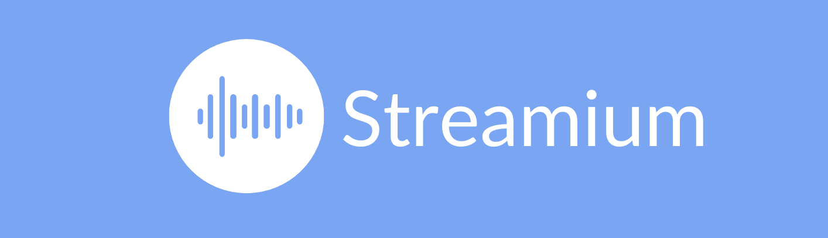
Hypothesis Statement
We believe that Patrick experiences an overload of content when searching for podcasts with insightful content. Patrick values his time a lot and he does not want to spend time looking for the right podcasts. He is also not willing to spent time listening to a whole podcast episode without knowing that it is worth his time. Addressing this issue would let Patrick find unique insightful content, although he would have to pay a fee for it.
Notes:
Assignment Session 5
Objective: Craft a hypothesis statement for your product/feature
We believe that <personas> experience <pain> when doing <task> because of <limitation> and alleviating that pain would let customers <achieve gain>, although they’d have to <accept this limitation>.

Slide 19
Customer Journey Map
Stage
Awareness
Consideration
Decision to listen
Subscription
Retention
Touchpoints & actions
Word of mouth, ads, social media, online mentions and search
Recommendations, influencers, reviews, topic relevance
App downloads, Sign ups
Listen to podcast, browse, review, share, favorite
Notifications, emails, ads, conversations in social media
User Experience
Motivations
Word of mouth, ads, social shares, online mentions and search
Recommendations, influence, reviews, topic relevance,
Value gain, positive reviews, influence on social media, content quality, convenience
Quality and quantity content, wide range of topics, keeps engaged and learns
Interesting content, notifications, emails, highlights from favorite content
Pain Points
Hard to find online, difficult name to remember, referral links not working
Not clear descriptions, unappealing/unprofessional podcast material appearance
Extensive sign up, not supported with all devices
Not relevant or interesting content, only one podcast to listen, bad audio quality, hard to find podcasts that i like
Forget to check for new content, requires a lot of time
Recommendations
Ideas for Improvement
Paid ads, guests with big audience, blogs, YouTube video mentions, Ads in audiobooks and music platforms
Create a trailer, review descriptions and materials
How to do tutorial, show-off recommendations, teasers of content
Rating podcasts,
ask for feedback, invite interesting guests based on feedback
Notifications, emails, highlights from favorite content
Notes:
Assignment Session 6
Objective: Create a Customer Journey Map
Source: http://pivotsix.com/blog/podcast-customer-journey

Slide 20
Minimum Viable Product (MVP)
Short 45-sec audio clips with exclusive content
Pre-recorded audio clips accessed via a button in the home screen. Button name “Listen to short clips”
Subscribe button for later subscriptions (helps to count desirability)
Delighter - Audio clips recorded with 10 top padcaster on the app. Exclusive only in our short clips. (eg Jason Bateman, Sean Hayes, Will Arnett etc)
Excluded features:
Audio clips prerecorded manually
No notifications yet
No subscription available
No sharing or favoring
No merchandise buying
No customization based on listener history
Notes:
Assignment Session 7
What is the single most important part of your product?
○ What delivers the real customer value
○ You likely talked about this in both your press release and review
○ This will define the core of your MVP
○ E.g., on Pinterest, it’s being able to pin a link. For a feature, it’s the main task the
feature lets you accomplish.
● Why are MVPs important?
○ Simple reason is that they let us get products out faster, get feedback, and iterate
○ But they also reduce product complexity/friction for customers
○ Imagine a 1-button product. Adding 1 simple button doubles its complexity.
● In the hybrid model we’re teaching, companies tend not to ship pure MVPs. They’ll ship a few extra features. But you want to really focus on prioritizing the right things with an MVP .

Slide 21
Product Requirements Document (PRD)
Mukul
Objective: Write a simple PRD
Highlights of PRD
Link to PRD here
Notes:
Assignment Session 7
Objective: Write a simple PRD

Slide 22
Product Wireframes
Team
Objective: Sketch product writeframes
Notes:
Assignment Session 8

Slide 23
Prototype
Team
Objectives:
Import your Balsamiq wireframes into Invision
Create a hotspot prototype in InVision
Notes:
Assignment Session 9

Slide 24
Six Month Product Roadmap (Signal)
July
August
September
October
November
December
Platforms
Storage AWS
Connection to AWS
Host content in S3
Establish logging system
Build pipeline to access storage
Establish logging system
Create listening services for new content
Features
Integration testing
Account creation - link Signal
Clips - circles
Track user comments
AB Testing
Sign up - link to Signal
Map Signal ID content with Podcast
Notifications Pane
React on comments
Auto download clips
Comments Spam detection
Develop Signal Gallery
Design Comments session
Lock screen notification
Like / Dislike Podcast
Share with friends
Design
Concept design
Wireframing
Prototype
Review, Sign off, Rollout
Testing & Iteration
Marketing
Develop
marketing plan
Execute marketing plan
Analytics
Performance Management
Notes:
Assignment Session 10
Objective: Craft a simple roadmap for your engineers and stakeholders
Source: https://www.altexsoft.com/blog/business/product-roadmap-key-features-common-types-and-roadmap-building-tips/
As a Listener I want to...
access exclusive podcast content, that I could know the latest content quickly, be on top of things without investing much time and listen to topics I’m interested.
listen to customized content based on my history in the app, so that I could discover new creators and expand my audio library to listen to.
receive notification when new short clips are released, that I could listen instantly or know that I could do it later, without going to the app to check the latest content.
subscribe to short clips feed or follow directly in the mobile app, so that I would not miss new content.
mark favorite short clip and share with friends, so that I could receive content suggestions based on my liking and express my interest with friend to continue discussion outside the platform.
buy merchandise via Signal, so that I could support Podcast Creator and use merch as a way of expressing my liking/hobbies/interests.
share my thoughts in the comments, so that I could express myself and connect to other people.
Review all Signal short clips gallery in one place, so that I could replay again or if I missed something.

Slide 25
Updated Product Roadmap 3-Week to Launch
July
August
September
October
November
December
W1
W2
W3
W4
Platforms
Storage AWS
Connection to AWS
Host content in S3
Establish logging system
Build pipeline to access storage
Establish logging system
Create listening services for new content
Features
Integration testing
Account creation - link Signal
Clips - circles
Track user comments
AB Testing
Sign up - link to Signal
Map Signal ID content with Podcast
Notifications Pane
React on comments
Auto download clips
Comments Spam detection
Develop Signal Gallery
Design Comments session
Lock screen notification
Like / Dislike Podcast
Share with friends
Design
Concept design
Wireframing
Prototype
Review, Sign off, Rollout
Testing & Iteration
Marketing
Develop
marketing plan
Execute marketing plan
Analytics
Launch planning
Notes:
Assignment Session 10
Objective: Craft a simple roadmap for your engineers and stakeholders
Source: https://www.altexsoft.com/blog/business/product-roadmap-key-features-common-types-and-roadmap-building-tips/
As a Listener I want to...
access exclusive podcast content, that I could know the latest content quickly, be on top of things without investing much time and listen to topics I’m interested.
listen to customized content based on my history in the app, so that I could discover new creators and expand my audio library to listen to.
receive notification when new short clips are released, that I could listen instantly or know that I could do it later, without going to the app to check the latest content.
subscribe to short clips feed or follow directly in the mobile app, so that I would not miss new content.
mark favorite short clip and share with friends, so that I could receive content suggestions based on my liking and express my interest with friend to continue discussion outside the platform.
buy merchandise via Signal, so that I could support Podcast Creator and use merch as a way of expressing my liking/hobbies/interests.
share my thoughts in the comments, so that I could express myself and connect to other people.
Review all Signal short clips gallery in one place, so that I could replay again or if I missed something.

Slide 26
Six Month Signal Release Plan
July
August
September
October
November
December
UX & Design
Concept design
Wireframing
Prototype
Review, Sign off, Rollout
Testing & Iteration
Dev
Backend development
Frontend development
Front end and back end integration
Testing
Marketing
Develop
marketing plan
Execute marketing plan
Analytics
Performance Management
Legal
Review legal updates required
Update terms and conditions
Roll out updated terms and conditions
Notes:
Assignment Session 10
Objective: Craft a simple roadmap for your engineers and stakeholders
Source: https://venngage.com/blog/product-roadmap/
https://www.slideteam.net/six-months-product-owner-development-estimate-roadmap.html
https://www.devteam.space/blog/how-to-build-a-podcast-streaming-app/

Slide 27
Customer Acquisition Channels via an Empathy Map
1
Who are we Empathizing with?
GOAL
2
What do they need to DO?
Busy Professional
Appreciation for quality information
Seeking competitive information. Wants to be the first to get news and be up to date
Looking for new perspectives on subjects he is
Keep using the app and Signal premium feature
Communicate with listeners via comments
Increase time spent on the app
3
What do they see?
7
Information overload
Seeking trusted sources of information
Listening to multiple podcasts
6
What do they hear?
What do they THINK & FEEL?
“I do not have enough time to vet all the possible sources of info I care about”
“There are too many sources of info. I don’t know what to listen/watch/read. I don’t have much time”
“Not all outlets have trustworthy information”
PAINS
GAINS
Information overload; difficult to decipher what is balanced and reliable
Access to responsible and diverse content
Hope to save time and effort to find reliable information sources
Analysis paralysis
What do they say?
4
“I wish there was a podcast app that consolidated short-form, quick content”
“I would love a community to discuss ideas and current events with, without judgement”
Fear of missing out of the most relevant information.
5
What do they do?
Long working days that go into client engagements
Interested in world affairs, financial markets, technology
Reads newspapers, listens to podcasts to stay up to date
Commutes into large city for work
Notes:
Assignment Session 11
Objective: Use an Empathy Map to help you determine the customer acquisition channels that best fit to capture customers for your product.

Slide 28
Customer Acquisition Channels via an Empathy Map
Objective: Use an Empathy Map to help you determine the customer acquisition channels that best fit to capture customers for your product.
Based on our Empathy map, potential customer acquisition channels:
Paid: LinkedIn, mentions through creator’s own social channels, co-sponsorships (trade shows, industry events)
Owned: In-app mentions through Streamium commercials, free trial to engaged Streamium users
Earned: Invitations through existing Signal users to sign up friends for a free trial of Signal
Notes:
Assignment Session 11

Slide 29
Customer Message
For busy professionals who appreciate quality information on-the go, Streamium’s new premium feature; Signal, provides subscribers with quick 45-second clips of exclusive content from your favorite podcast creators. Unlike our competitors, Signal organizes user’s relevant quick-hit information the home screen and allows the opportunity to interact with your fellow Signal community to discuss opinions and viewpoints related to the content. In addition, the Signal shop feature showcases items for purchase from your favorite creators, so fans can sport their Signal pride further displaying their involvement and knowledge in specific topics and spaces.
Notes:
Assignment Session 12
Objective: Create your customer message

Slide 30
Go to marketing strategy; the four Ps
Product
Price
Place
Value Proposition
Strengths
Tiered monthly cost:
Podcasts only: Free
Premium +: Single-user, $9.99
Premium Group: Up to 10 people, $29.99
In-app/desktop version
Signal is a Streamium Premium feature serving exclusive :45 audio clips, commenting functionality to connect with other users, and in-app purchases
Feature within an existing app
Existing listener base and creators
Incentive for creators to join the app to further drive engagement
Product
Promotion
Top Personas
Weaknesses
Top Followers
Podcast Creators
Unsure how feature will catch on given established user behavior
Reliance on creators for content
Competitors have rights to exclusive content
Tiered monthly cost:
Podcasts only: Free
Premium +: Single-user, $9.99
Premium Group: Up to 10 people, $29.99
Notes:
Assignment Session 12

Slide 31
Go To Market Strategy
Internal Logistics
Launch Event
Post Launch
Internal Testing -
Once MVP is ready, conduct a beta test amongst internal stakeholders and three top creators use insights to finalize feature and offer exclusive contracts as incentives to creators to be early adopters of Signal at launch.
Necessary Assets -
Creator profile pictures for Signal circles
Signal announcement assets - email, logo, landing page
Creator memo and how-to guidelines and code of conduct for Signal content
Partnerships -
Consider relationships with top Streamium creators to help build buzz and participate in Signal feature to draw in users
Reach customers through our owned channels, email communication and in the tech trades/blogs
Hold Virtual Press Conference Launch Event - get users excited about new feature and participating creators
Offer free trial subscriptions to entice conversion
Continue in-app commercials on free users' experience

Slide 32
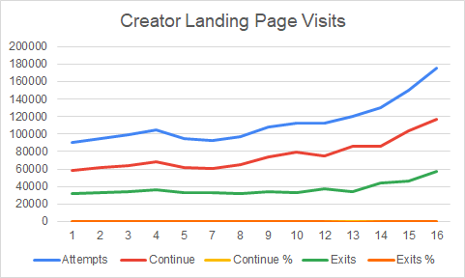
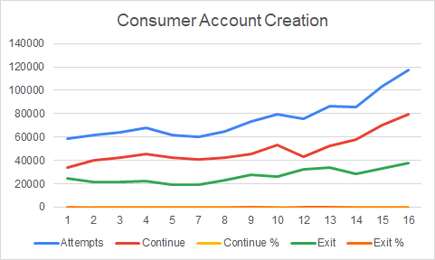
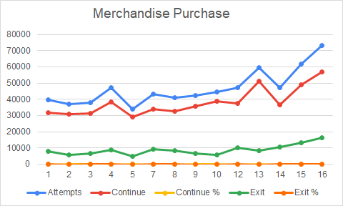
Launch Summary and Hypothesis based on data
Nicole
Based on the purchase conversion funnel weekly data from January to March 2020, there is a steady high conversion of Streamium users who visited the in-app purchase feature. An average of 83% of users completed an in-app purchase, and only 17% did not buy.
Based on the same data there is a clear opportunity to increase Signal account creation, as we saw an average of 38% of listeners did not create a Signal account in the same period.
Therefore, if we increase the number of Signal accounts created, we will also see an increase in the number of successful in-app purchases given that there is a clear correlation between the two actions.
As a next step, we will focus our efforts on increasing user account creation. In our analysis of the data, we noticed a high percentage of visitors exiting the Creator landing pages.* We will aim to increase the success rate of attempted account creation by running an A/B test offering incentives such as free trials against in-app messaging showcasing the benefits of the Signal feature.
*Creator landing page assumes Podcast-specific landing pages (i.e.; Podcast home screen, individual episodes, Streamium homepage)
Notes:
Assignment Session 13

Slide 33
Product Iteration - Prototype
Add Prototype - in app messaging screens showcasing the A/B test

Slide 34
Product Iteration - Conclusion
After conducting our A/B test and reviewing the data, we found offering a free trial subscription led to more conversions of free users to paid Premium subscribers. This additional revenue has been incremental to support our funding needs for our infrastructure budget.
Notes:
Assignment Session 12
Objective: Create your customer message

Slide 35
Backups

Slide 36
Product Iteration - Agile Retrospective
Objective: Conduct an agile retrospective
Notes:
Assignment Session 13

Slide 37
Other Tasks
WIP 8.31.2020 | Team 3

Slide 38
About the feature - Signal (1)
A new feature on the Streamium iOS and Android app that allows creators to send notifications to their top followers that exclusive content is available via 45 second audio clips.
The audio clips form an RSS feed that consumers can subscribe to, or follow directly in the mobile app - where they can favorite and share with friends.
Development has gone well and you're slightly ahead of schedule.
The core 45 second clips are complete but the other elements are still in development together.
Task: This morning, the head of product comes to your desk and tells you that the CEO is working to raise Streamium next round of funding and wants to talk about this feature. They want you to move up the launch from 2 months out to 3 weeks out.

Slide 39
About the feature - Signal (2)
Opportunity Hypothesis
Based on the purchase conversion funnel weekly data from January to March 2020, there is a steady high conversion of Streamium users who visited the in-app purchase feature. An average of 83% of users completed an in-app purchase, and only 17% did not buy.
Based on the same data there is a clear opportunity to increase Signal account creation, as we saw an average of 38% of listeners did not create a Signal account in the same period.
Therefore, if we increase the number of Signal accounts created, we will also see an increase in the number of successful in-app purchases given that there is a clear correlation between the two actions.
As a next step, we will focus our efforts on increasing user account creation. In our analysis of the data, we noticed a high percentage of visitors exiting the Creator landing pages.* We will aim to increase the success rate of attempted account creation by running an A/B test offering incentives such as free trials against in-app messaging showcasing the benefits of the Signal feature.
*Creator landing page assumes Podcast-specific landing pages (i.e.; Podcast home screen, individual episodes, Streamium homepage)

Slide 40
Task 1: Prepare a presentation to the product team
informing about new timeline for feature release (Signal)
Reduce scope and still roll out Signal for maximum impact using best judgement on how Signal might work
New deadline
Walk through launch plan for the next 6 weeks
Product development
Marketing
Legal
Definition of key performance indicators (KPI)
Notes:
Part 1: Given the tighter timeline, you're going to need to find a way to reduce scope and still roll out Signal for maximum impact. Using your best judgement on how Signal might work, lay out the presentation that you'd give your team, inform them of the new deadline, and walk through your launch plan for the next 6 weeks from product development, marketing, legal, and key performance indicators (KPI) definition.

Slide 41
Task 2: Develop a communication strategy
to inform users about the downtime (1-week) of Signal
Due to the high cost required by Signal’s infrastructure the feature will have to be taken down while the engineers develop a more efficient solution
How would you communicate this downtime to users and what would you say, knowing people will be disappointed?
Notes:
Part 2: The launch goes well and the CEO has been getting a lot of mileage from showcasing Signal at investor meetings. However, the infrastructure team has noticed that these new sound clips are quickly putting a strain on servers and bandwidth, and you're racking up a really big infrastructure bill. Given your company's financial situation, finance is forcing you to take down the feature while the engineers develop a more efficient solution (they say they can be ready in a week). How would you communicate this downtime to users and what would you say, knowing people will be disappointed?

Slide 42
Task 3: (A/B Testing)
Signal has now enabled in-app purchases for creators looking to sell merchandise to their audience.
3 month of purchase funnel data have been acquired
to better understand how consumers are navigating through experience and completing a purchase when consumers are registering to Streamium as a new user
Based on the weekly data provided you’ll need to observe what's happening in the product and propose an opportunity hypothesis to improve the conversion across the key touchpoints in the experience.
The key questions to consider are the following:
What are the key observations/trends in the traffic, account creation and purchase?
What opportunities are you able to identify to improve the conversion lift? What would be your target lift in conversion?
(Hint: In order to know what to target, you’ll need to have historical context of your product funnel.)
Notes:
Part 3 (A/B Testing): Signal has now enabled in-app purchases for creators looking to sell merchandise to their audience. You’re the PM and you’re able to acquire 3 months of purchase funnel data to better understand how consumers are navigating through experience and completing a purchase when consumers are registering to Streamium as a new user. Based on the weekly data provided you’ll need to observe what's happening in the product and propose an opportunity hypothesis to improve the conversion across the key touchpoints in the experience. The key questions to consider are the following:
What are the key observations/trends in the traffic, account creation and purchase?
What opportunities are you able to identify to improve the conversion lift? What would be your target lift in conversion? (Hint: In order to know what to target, you’ll need to have historical context of your product funnel.)

Slide 43
Backups

Slide 44




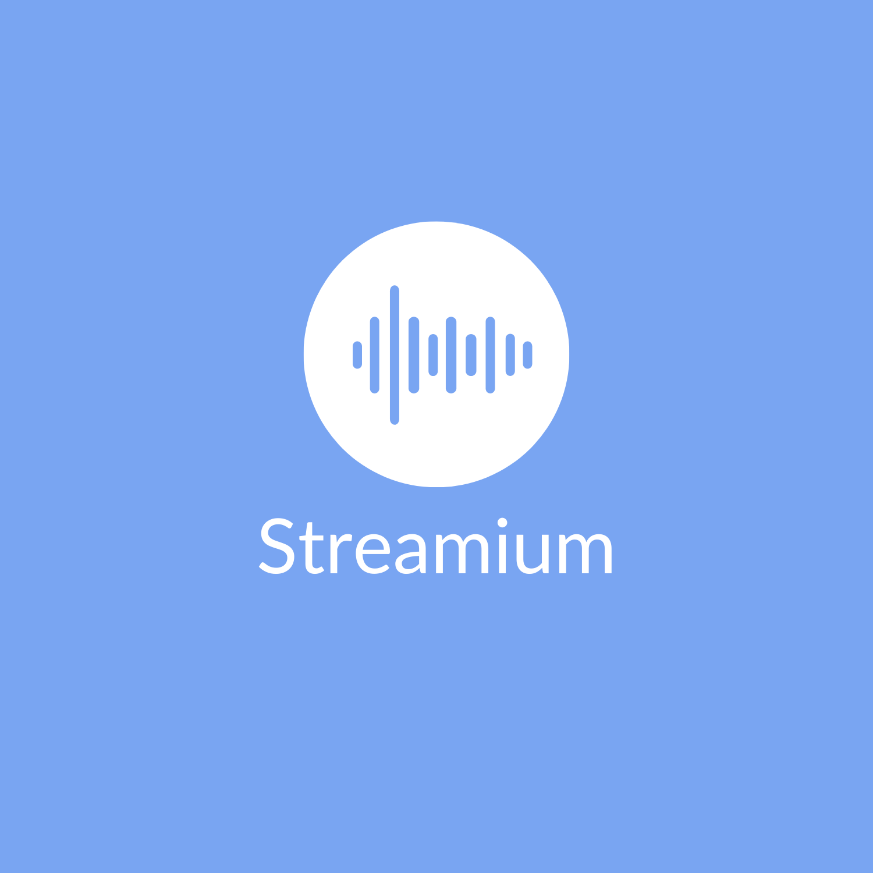


Slide 45
Personas
Persona
Reasons to use our product
Reasons to buy our product
Access to variety of topics
Access to exclusive content; 45 sec audio clips
Podcast creators
Podcast listeners
Ops. People
Free for all listeners
Finds unique
content
Hosts
Guests
Top Followers
New listeners
Access to most popular podcasters
Easy to use
Producers
Occasional listeners
Regular
listeners
Advertising / Marketing
Personality
Interests
Skills
Tech Savviness
Have a post-secondary degree or more and employed full-time
Between 18-54 years old; leans slightly male
Access the latest information from industry / news / interests
Wants to feel productive at all times
Comfortable using technical devices e.g. computers and smartphones
Consumes audio content via tech platforms
Busy schedule. Podcast are a great way to stay informed while multitasking
More likely listens to podcast at home. Starting to listen in the car too
To be entertained
More likely to use their smartphone as their primary podcast player
Notes:
Assignment Session 2
Objective: Craft Personas for our project in Miro for Streamium

